Slide 1

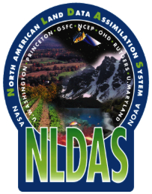
NLDAS OD Briefing
27 April 2018 North American Land Data
Assimilation System (NLDAS)
Version 2.5.0 -- an Upgraded Implementation
Youlong Xia and Jack Kain
NCWCP, 5830 University Research Court, College Park, Maryland

Slide 2
NLDAS: Partners
NLDAS Forcing and Land Model Development:
Noah, R2O − J. Kain, Y. Xia, H.Wei, J. Meng, J. Dong (NCEP/EMC)
LIS NLDAS− D. Mocko, C. Peters-Lidard, S. Kumar (NASA/GSFC)
Noah, Noah-MP − M. Ek (UCAR); F. Chen (NCAR); Z-L Yang(UT-Austin), G.-Y. Niu (U. Arizona)
Mosaic, Catchment – R. Koster (NASA)
SAC, NWM − B. Cosgrove, David Kitzmiller (NWS/NWC)
VIC − M. Pan and E. Wood (Princeton U.), D. Lettenmaier(UCLA)
Seasonal Hydrological Forecast − L. Luo (MSU)
Forcing − B. Livneh (High-res, U. Colorado); A. Wood (ensemble, NCAR)
NLDAS Maintenance and Operational Transition:
− Y. Xia (NCEP/EMC), Eric Rogers (EE2 EMC), Simon Hsiao (NCO)
NLDAS Products Application:
− K. Mo, L. Chen, M. Chelliah, M. Rosencrans(NCEP/CPC)
− Eric Luebehusen (USDA), J. Case (NASA), M. Hobbins (ESRL/PSD), USDM Author Group, Regional Climate Centers, Missouri River Basin Water Management, etc.
2

Slide 3
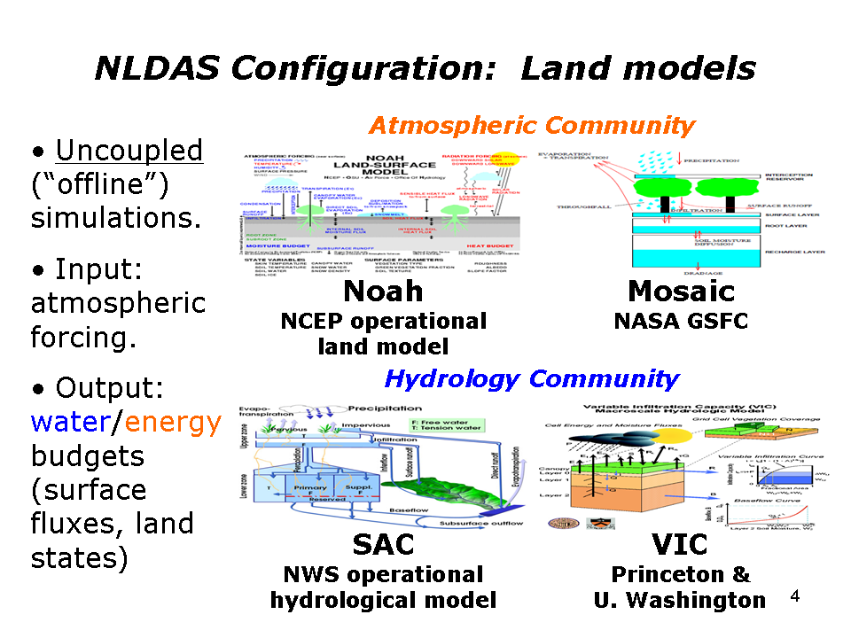
NLDAS: Land Models
3

Slide 4
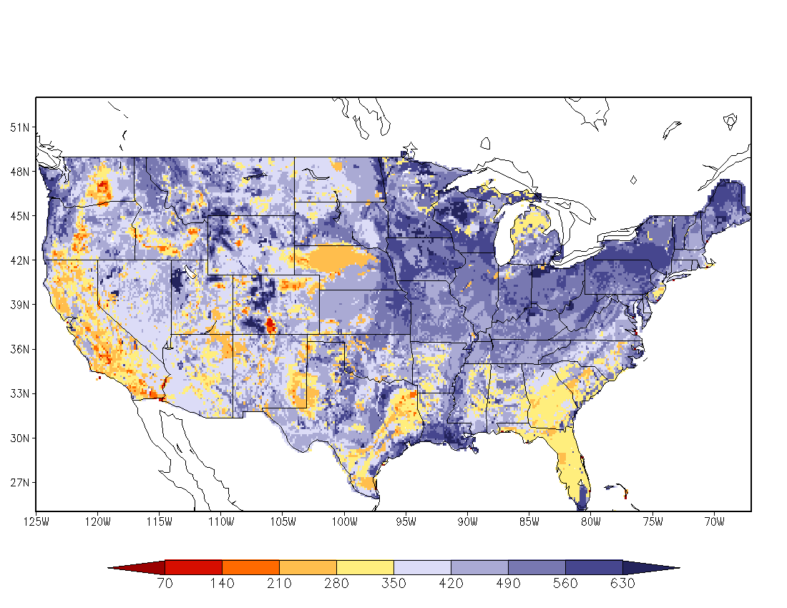
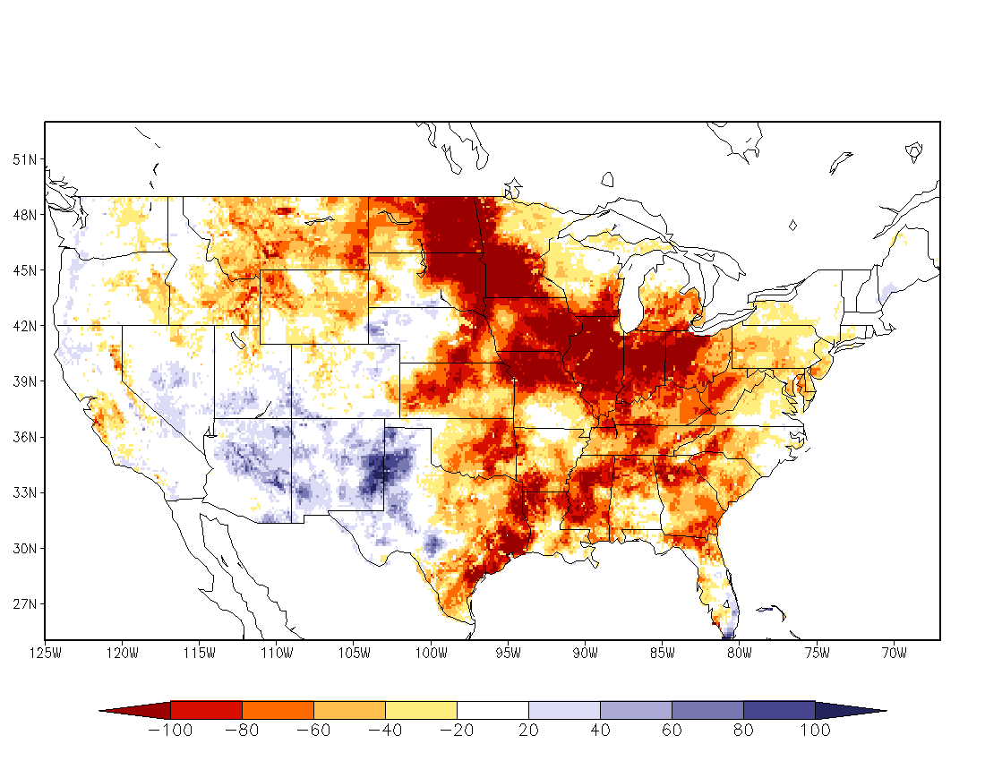
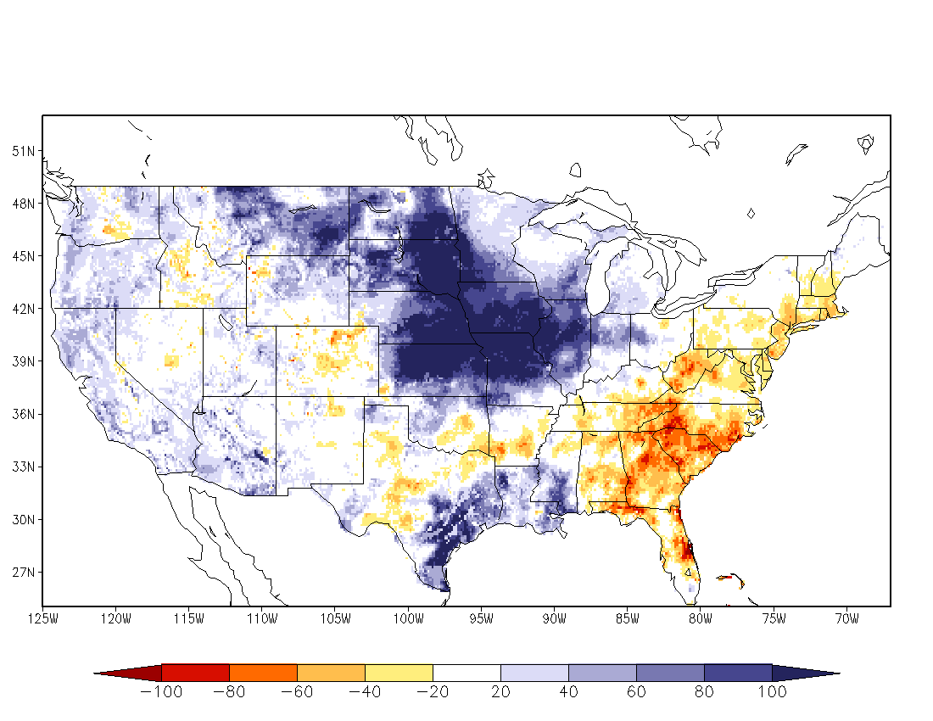
NLDAS: Simulations
Use NARR/RCDAS based forcing with observed precipitation and bias-corrected shortwave downward radiation, uncoupled simulation system
30-year retrospective land model runs, Oct 1979 – Sep 2008 (after 15-year spin-up) to provide land model climatologies.
Quasi-operational, Sep 2008–Jul 2014
NCEP operational, Aug 2014 - present, hourly, 1/8th degree, NLDAS domain (CONUS, southern Canada, northern Mexico).
Land model output: surface fluxes (latent, sensible, &soil heat fluxes, net radiation), soil states (soil moisture, temperature & ice), snowpack, runoff/streamflow.
Depict conditions as anomalies and percentiles to support US drought monitor.
Ek et al., GEWEX Newsletter, 2011, Xia et al., JGR-Atmos., 2012
July 30-year climatology
July 1988 (drought year)
July 1993 (flood year)
NLDAS four-model ensemble monthly soil moisture anomaly
4

Slide 5
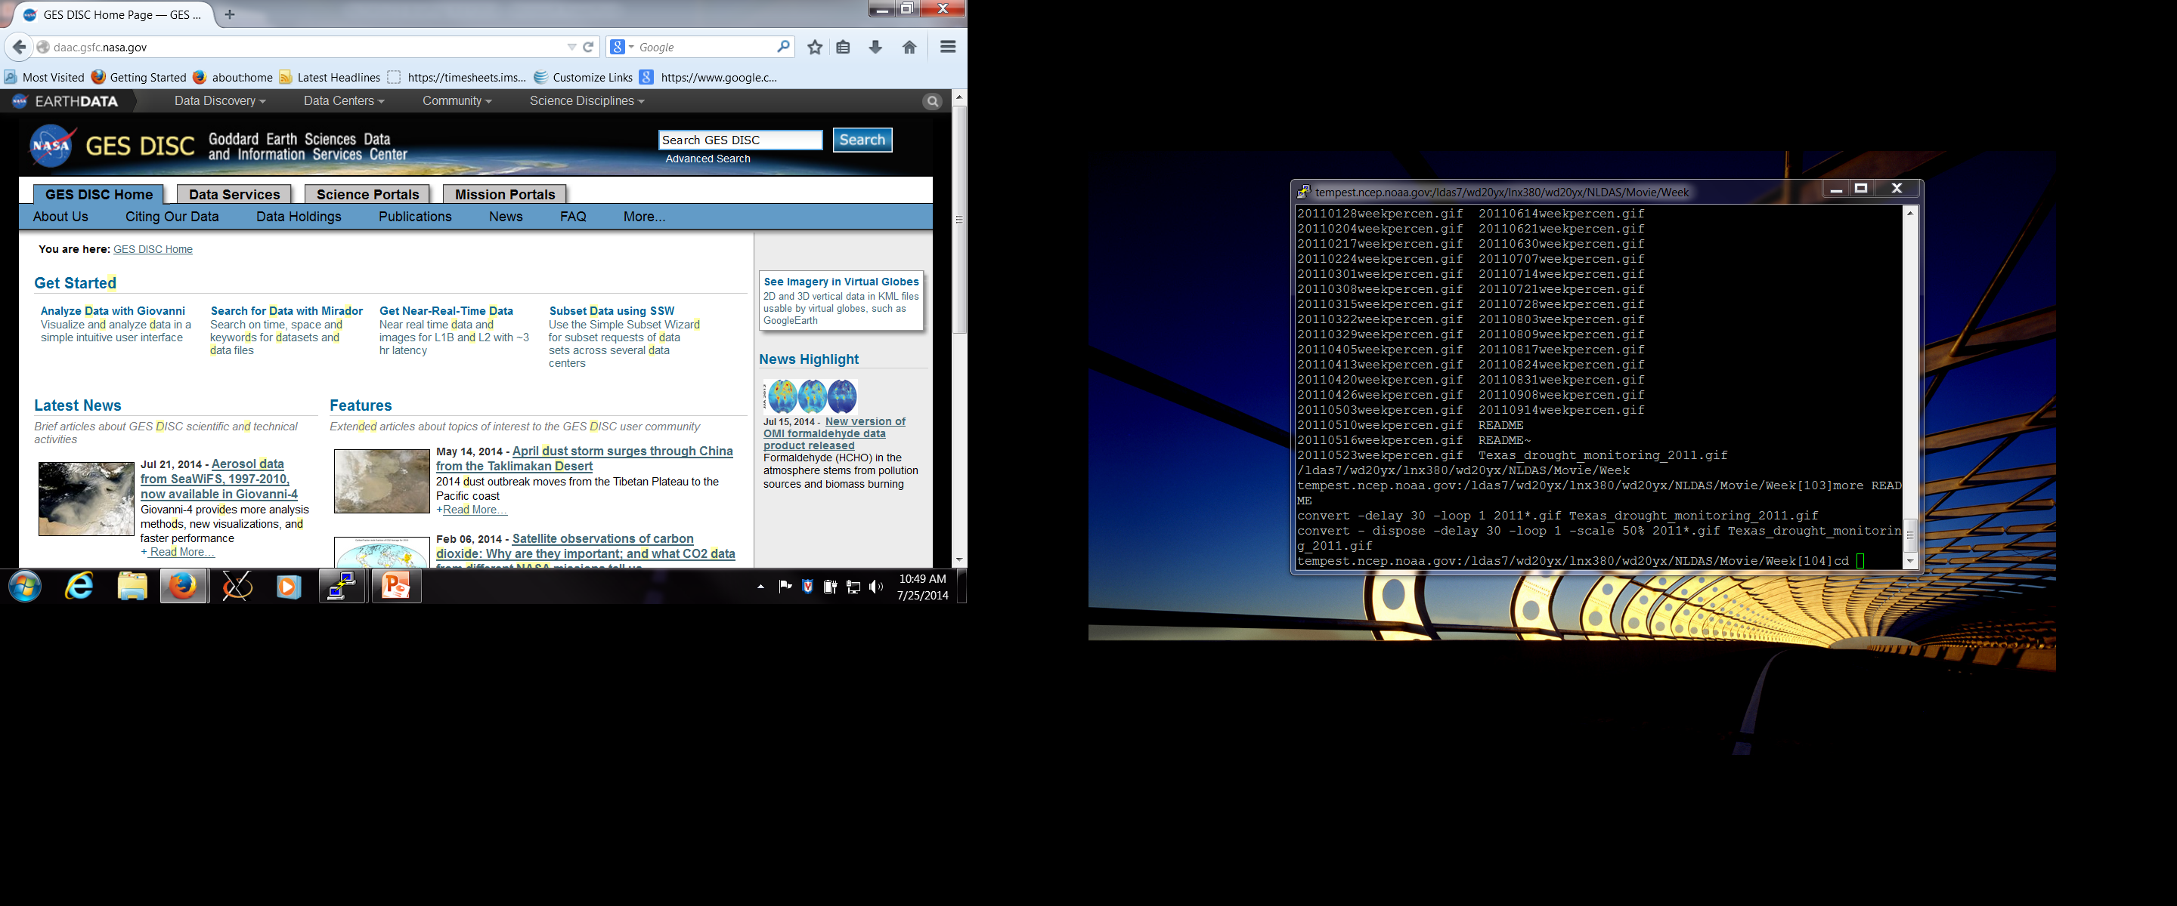
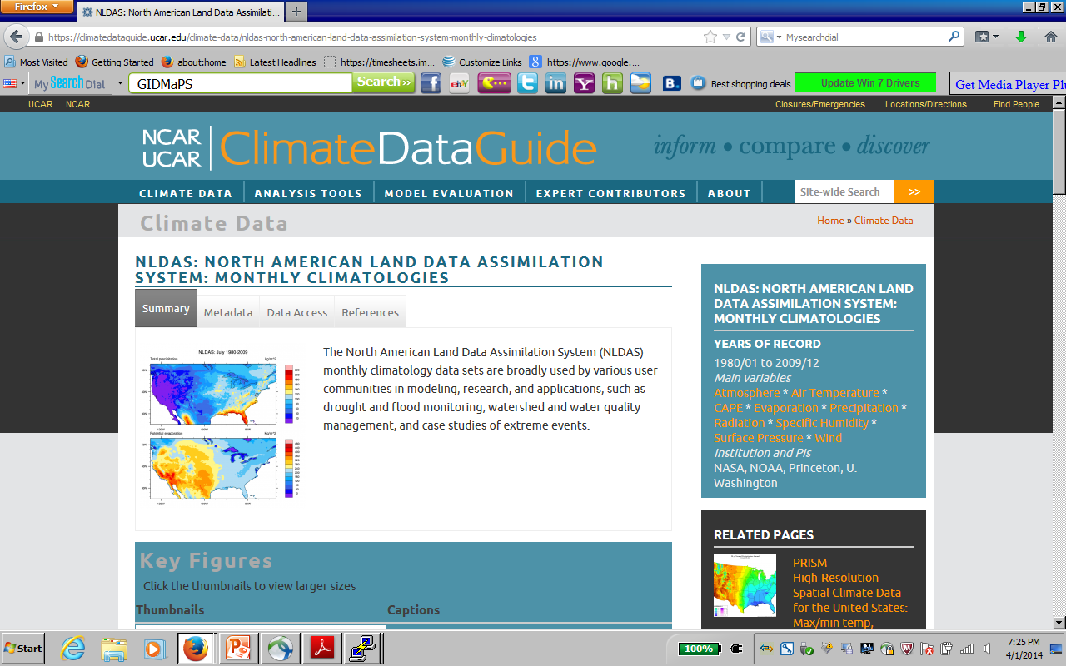


NLDAS Users Information Report
Users Statistics Information from NASA/GES/DISC website – an example
Thousands users are using our ops NLDAS products and need real-time products
Year | No. of Users | No. of Files Downloaded | Total Volume Downloaded
2017 2016 | 5279 5038 | ~ 56 million ~64 million | 149 TB 149 TB
2015 | 5392 | ~71 million | 144 TB
2014 | 5437 | ~44 million | 93 TB
2013 | 4868 | ~ 36 million | 66 TB
NASA
Statistics
EMC LDAS ftp://ldas.ncep.noaa.gov/nldas2/

Slide 6
Our NCEP/EMC NLDAS team acknowledges all NLDAS partners for their contributions. As NLDAS v2.0 has a 3.5-4 day lag behind real-time, based on users’ request (e.g., USDM) and our survey conducted in 2016 and 2017, we update NLDAS v2.0 into version 2.5 by using various feasible data sources (NAMv4, Stage IV) to catch up real-time system (zero day lag).
Highlight: Add real-time products to NLDAS users in support for various national operational drought, NWP forecast, and water resources management tasks
6

Slide 7
To be clear… NLDAS 2.5 complements NLDAS 2.0 in the same way that RTMA complements URMA: NLDAS 2.0: Analysis of Record NLDAS 2.5: NLDAS 2.0 & Extra 4-day Interim Analysis

Slide 8
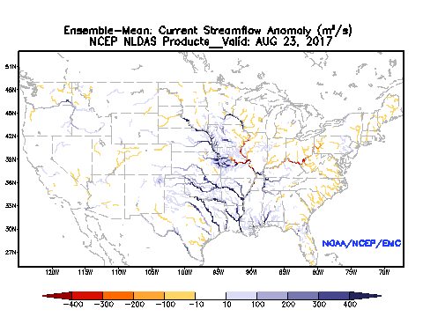

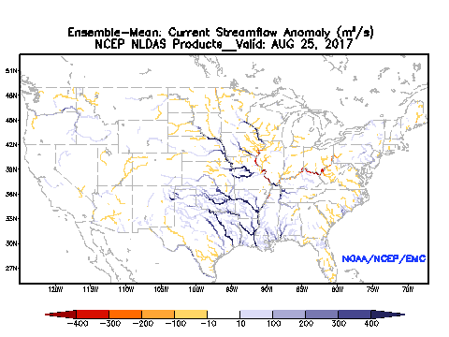
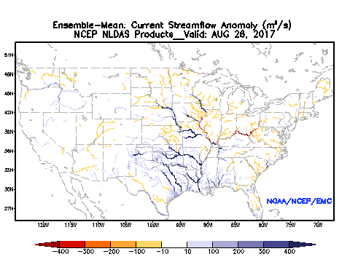
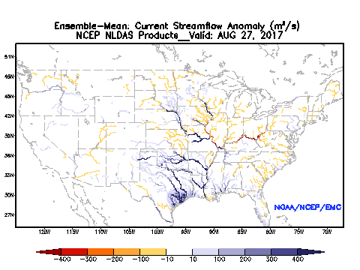

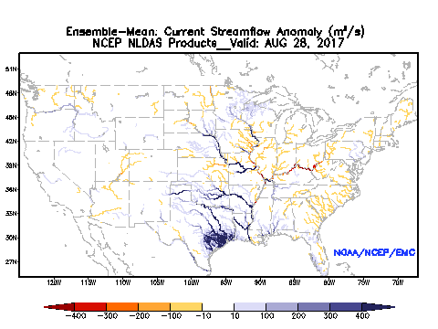
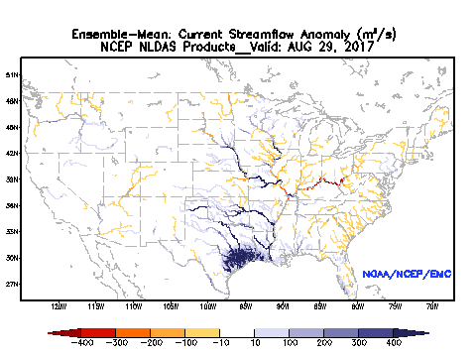
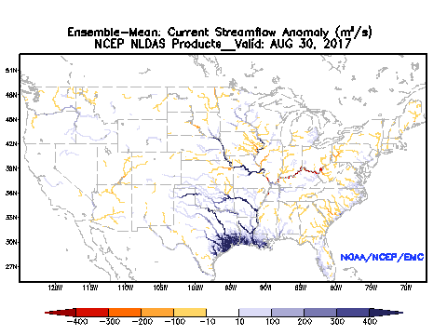
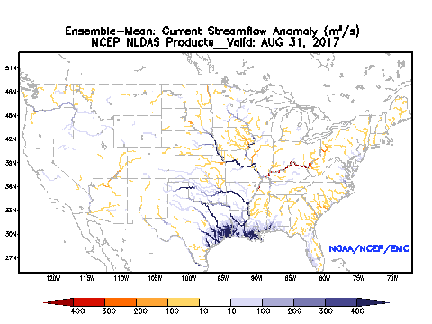
NLDAS2.0 vs NLDAS2.5 (Harvey Case)
Daily Streamflow Anomaly
23 AUG
24 AUG
25 AUG
NLDAS v2.0
26 AUG
27 AUG
27 AUG
Analyses available same time
28 AUG
29 AUG
NLDAS v2.5
30 AUG
31 AUG
Timing has large impact for monitoring flood situation

Slide 9
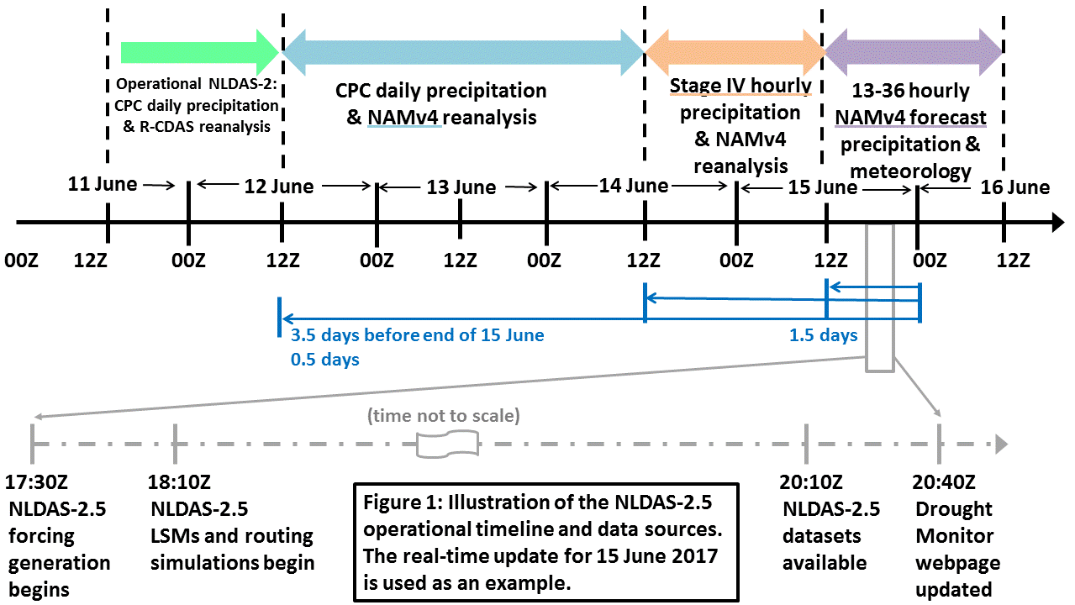
NLDAS v2.5 Flowchart (12Z - 12Z cycle)

Slide 10
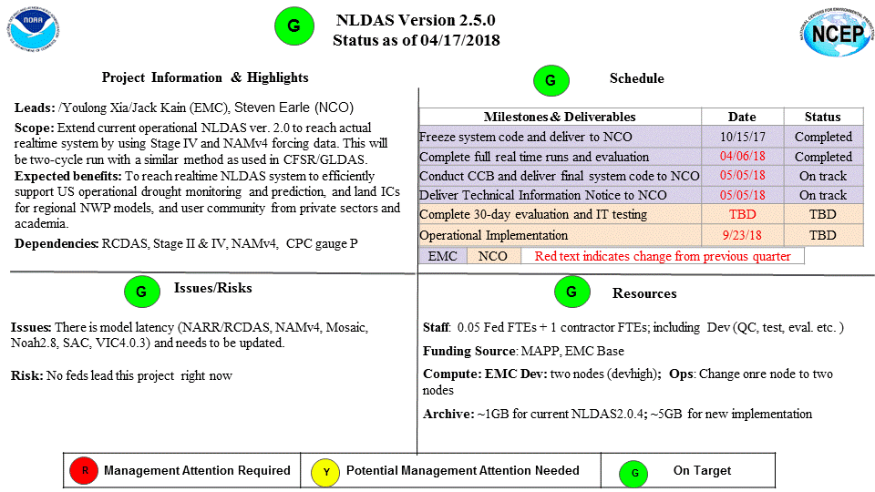
EMC NLDAS v2.5 Quads
Long-term (>30 years) and consistent high quality observations and reanalysis are expected
10

Slide 11
NLDAS V2.5.0 Products:
Evaluation and Validation
Most NLDAS 2.0 products have been well comprehensively evaluated against in situ observations and/or remotely sensed data by EMC NLDAS team and its partners. The results were documented in various journal papers and presentations (https://ldas.gsfc.nasa.gov/nldas/NLDAS2valid.php, https://ldas.gsfc.nasa.gov/nldas/NLDASpublications.php).
Major purpose for this upgrade is to catch up 4-day delay to achieve a real-time system. The data quality will become lower when the data is approaching real-time. Bottom line: NLDAS v2.5 is an add-on, not a replacement of NLDAS v2.0
Besides we made our own evaluation and monitoring work for NLDAS v2.5 (about 9 months), NASA/GSFC, CPC, NASA-MSFC, ESRL/PSD, and USDA partners also made their own subjective evaluation for NLDAS v2.5.
11

Slide 12
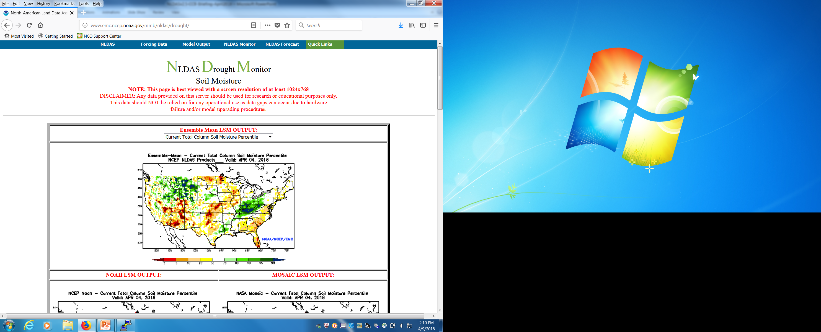
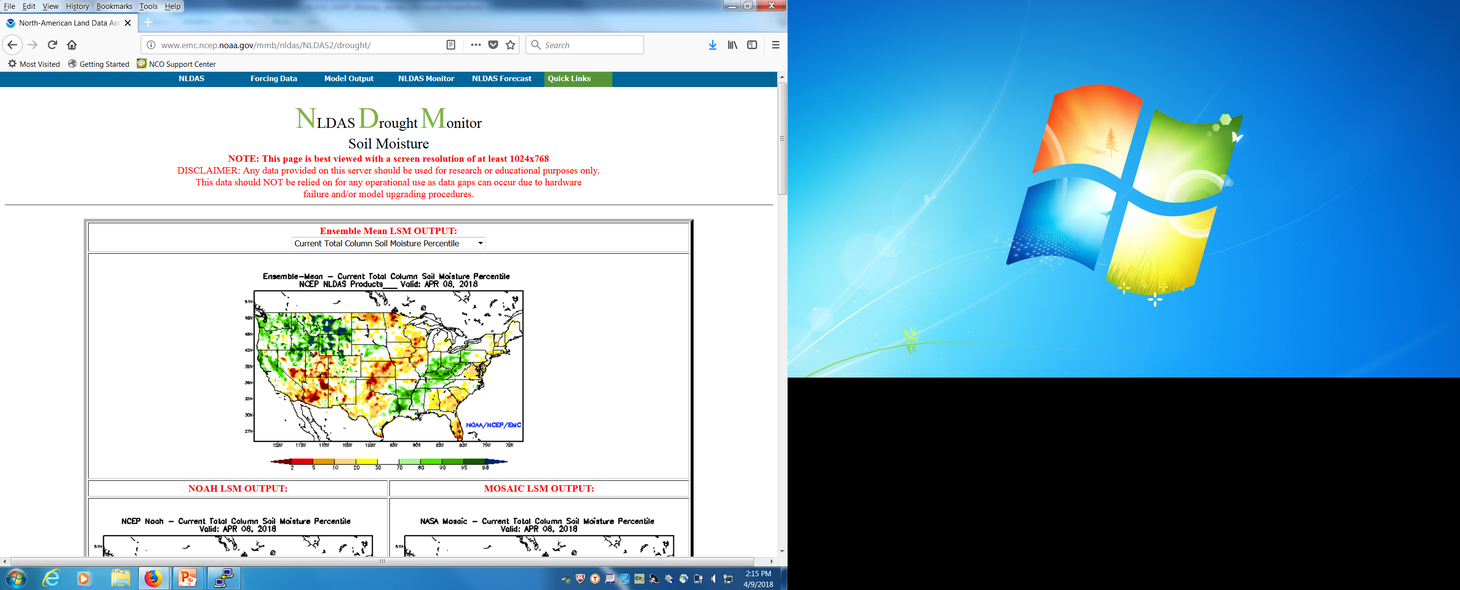
Near Real-time NLDAS v2.0 and Real-time v2.5 drought monitor
Parallel run daily drought monitor
NLDAS v2.0 with 4-day delay
Real-time NLDAS v2.5
http://www.emc.ncep.noaa.gov/mmb/nldas/
http://www.emc.ncep.noaa.gov/mmb/nldas/NLDAS2/
Anomaly and percentile (daily, past week and month) for SM1m, SMtotal, total runoff, routed streamflow, SWE, and ET (4 models: Noah, Mosaic, SAC, VIC, and their ensemble mean)
12

Slide 13
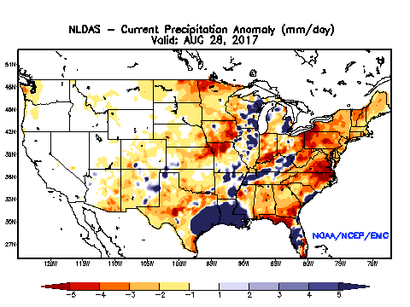
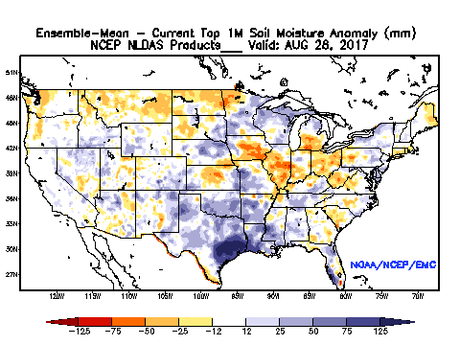
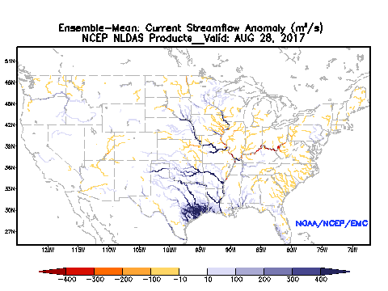
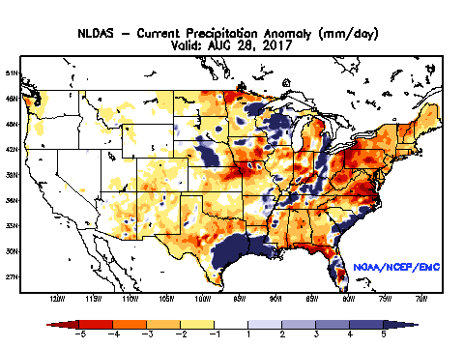
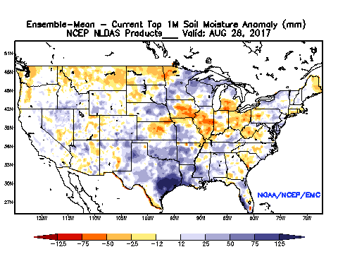
Harvey Case Comparison: NLDAS v2.0 vs NLDAS v2.5
NLDAS v2.0 (generated on 1 September 2017)
NLDAS v2.5 (generated on 28 August 2017)
v2.5 reasonably captures impact of Harvey precipitation immediately and the difference between the two systems is small

Slide 14
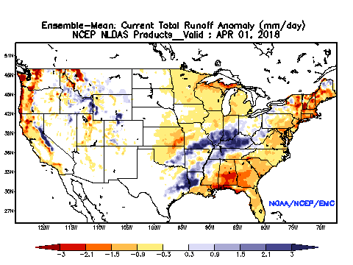
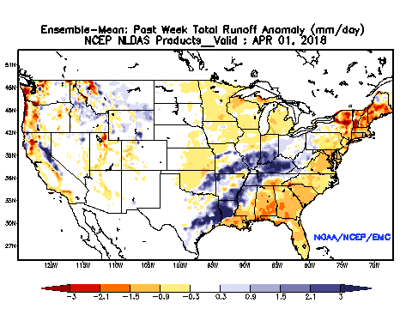
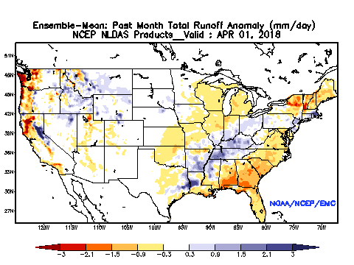
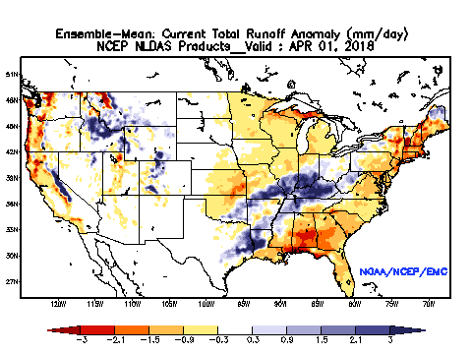
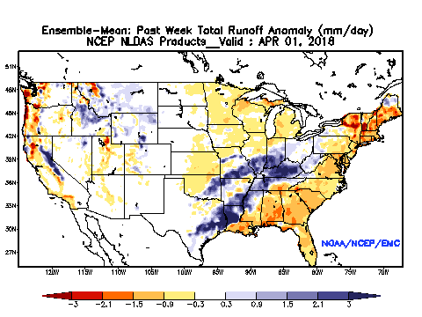

Comparison of total runoff for 3-timescale on 1 April 2018
Near Real-time NLDAS v2.0
Daily Past week Past month
Some difference
Real-time NLDAS v2.5
In spite of some difference in daily total runoff anomaly, weekly and monthly results are quite similar
14

Slide 15
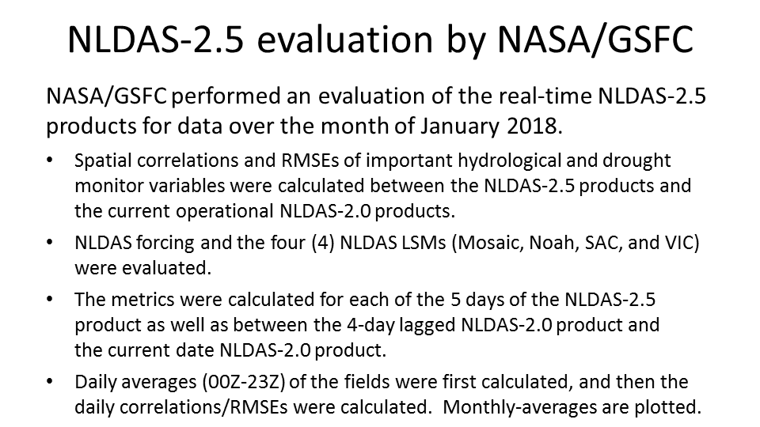
NLDAS v2.5: Users Evaluation
Benchmark – persistence, use NASA/GSFC as an example
15

Slide 16
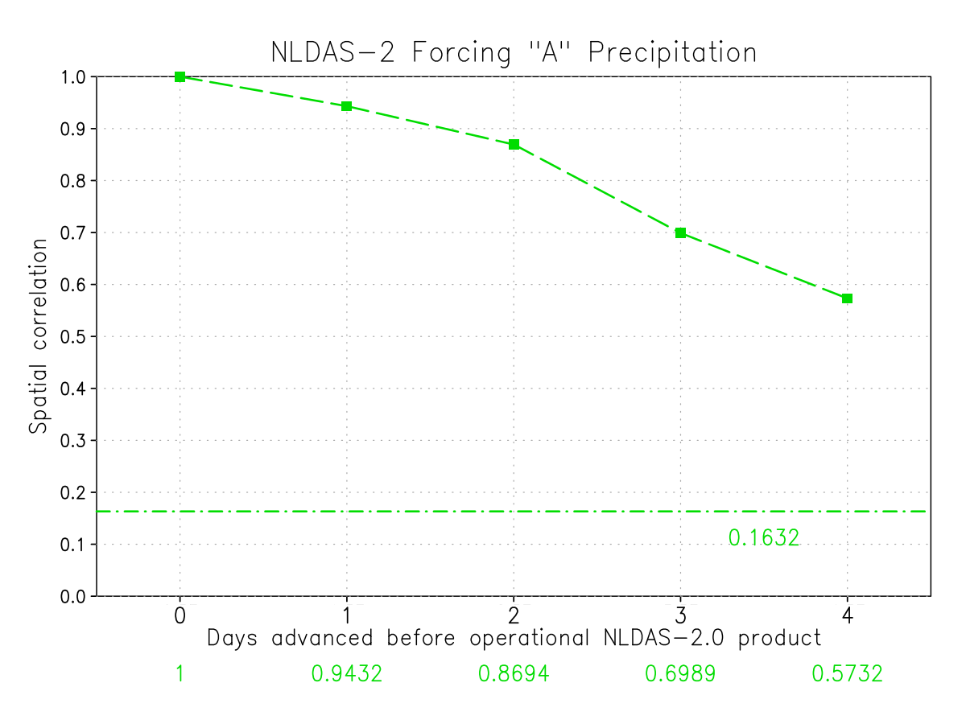
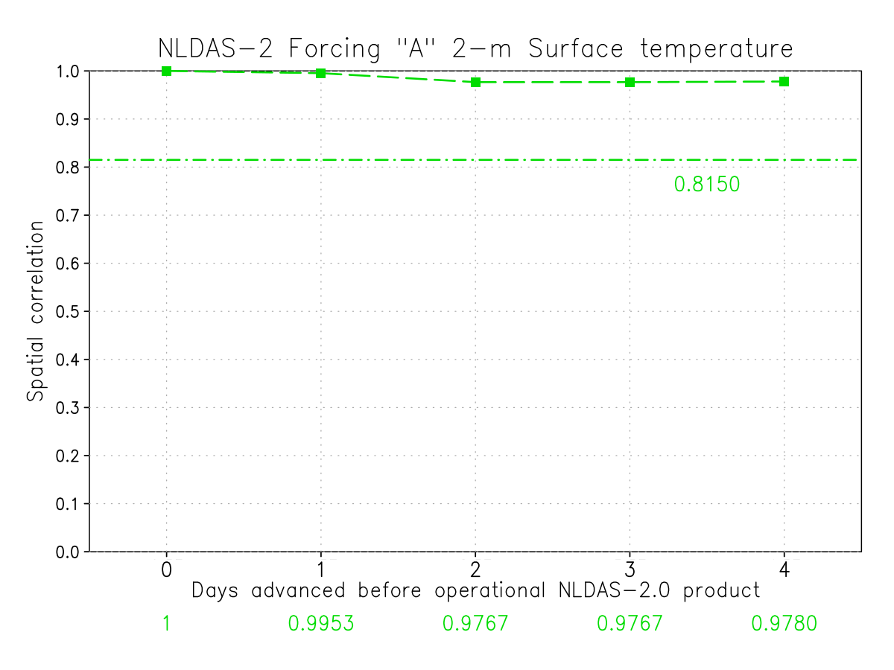
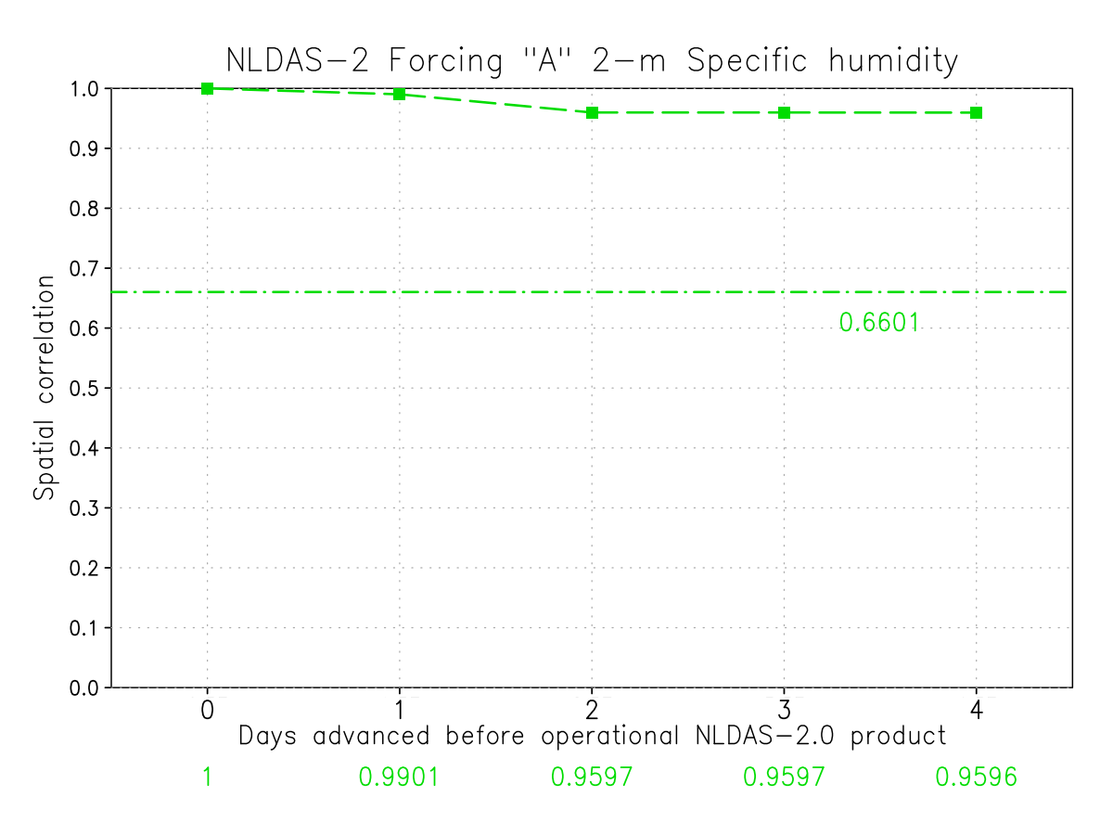
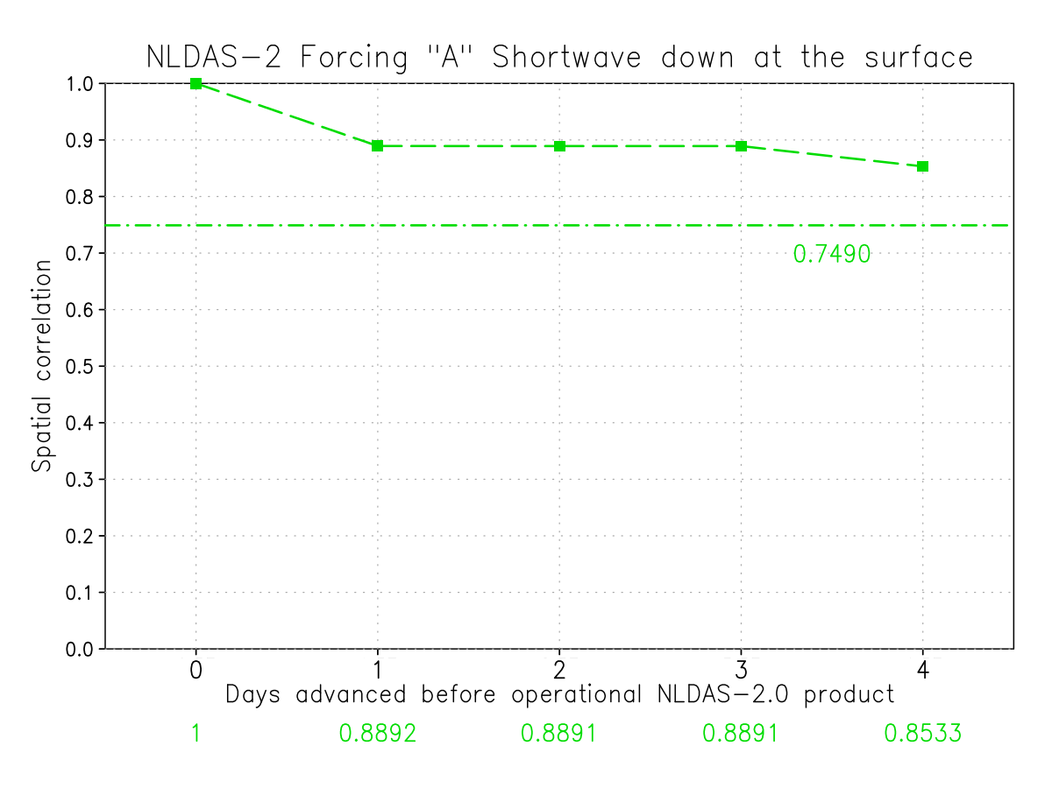
NLDAS v2.5 Forcing and Output Evaluation
(a) Precipitation
(b) 2m Air Temperature
NLDAS 2.5 above flat line (benchmark) indicates that forcing is improved!
(c) 2m Specific Humidity
(d) Downward Shortwave
16

Slide 17
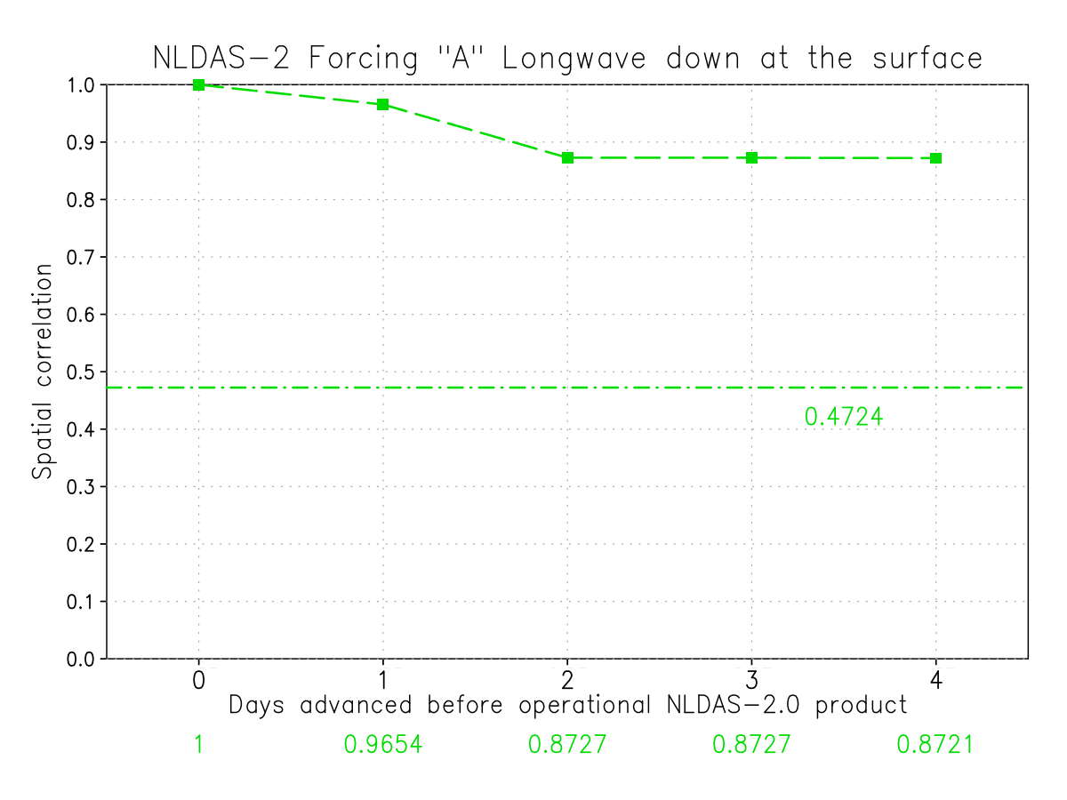
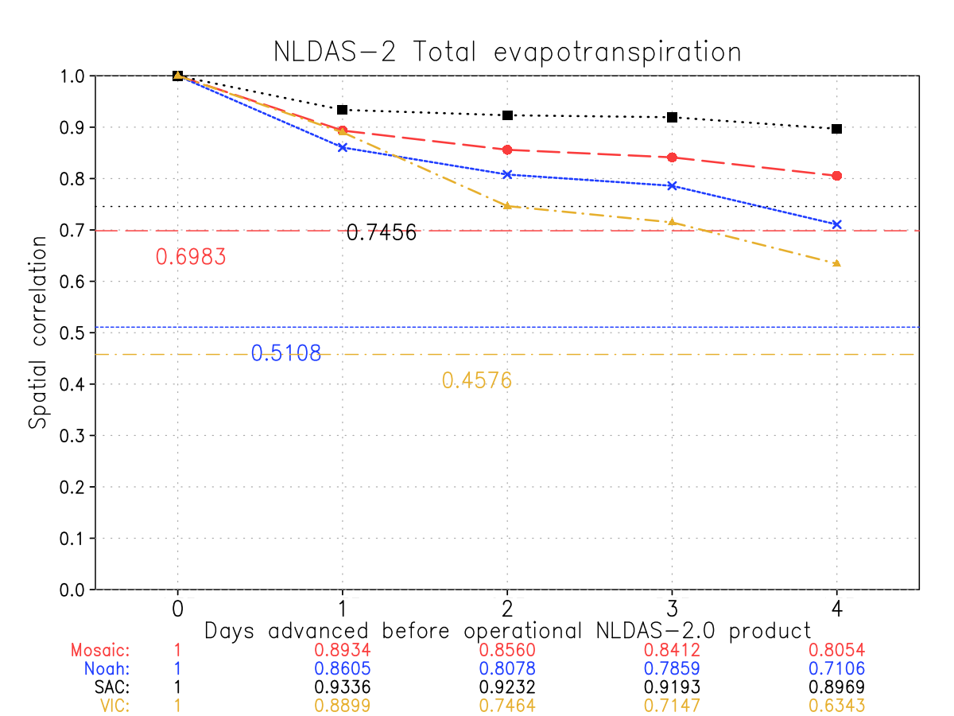
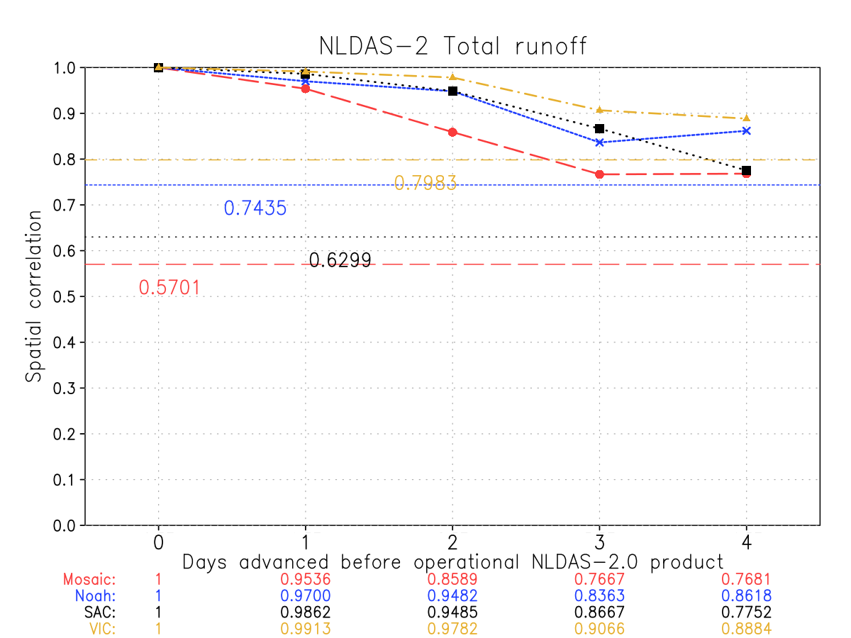
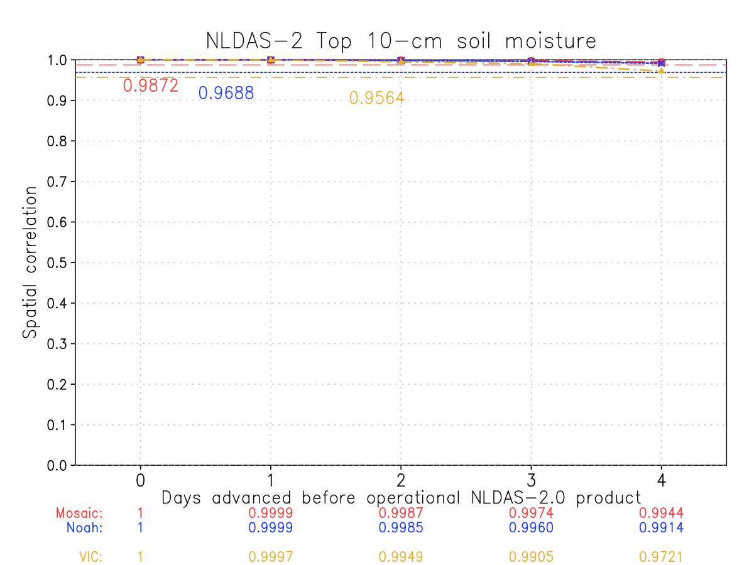
NLDAS v2.5 Forcing and Output Evaluation (Cont.)
SAC
Mosaic
Noah
VIC
(a) Downward Longwave
(b) ET
Model output is also improved!
(c) Total Runoff
(d) Top 10 cm SM
17

Slide 18
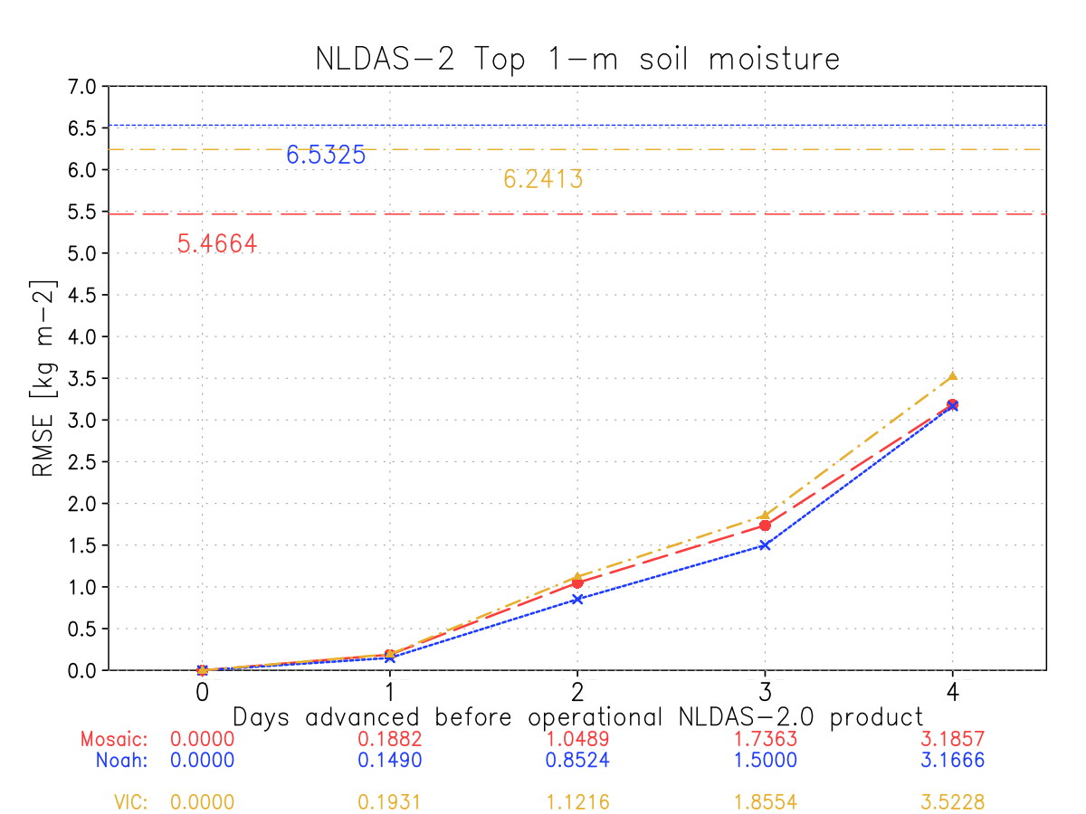
NLDAS-2.5 LSM evaluation - RMSE
Day 4 (current date):
NLDAS-2.5 has the highest RMSE values compared to the NLDAS-2.0 on the same date (half the precip. is from the NAMv4 forecast; the other half is from Stage II)
Day 3 (1-day lag):
Precip. ½ from Stage II and half from CPC analysis
Day 2 (2-day lag):
Precip. from CPC analysis
Day 1 (3-day lag):
Precip. from CPC analysis
Day 0 (4-day lag):
Precip from CPC analysis. RMSE = 0 because it is the same day and precip source as NLDAS-2.0.
The flat line on the top represents the RMSE between the NLDAS-2.0 precip. on a day against the NLDAS-2.0 precip. 4-days earlier. In other words, if you only had the 4-day lagged NLDAS-2.0 precip. on the date you need the latest NLDAS dataset (aka, the current operational system), how useful would it be? The lower RMSE value of the NLDAS-2.5 product below this flat line show that NLDAS-2.5 is improved.
Noah
VIC
Mosaic
Volumetric <3.5%
18

Slide 19
Summary of Evaluations from 5 Institutions
NLDAS-2.5 real-time products are an improvement over using NLDAS-2 4-day lagged products for operational drought monitoring.
The current NLDAS-2 system should continue to run operationally to provide a long-term consistent climatology.
Evaluations recommend that the NLDAS-2.5 system be run operationally in its present form.
Radar precipitation needs to be improved and surface forcing data error caused by change from RCDAS to NAMv4 needs to be reduced in future.
19

Slide 20
Information of 5 Evaluation Institutes
All evaluation Institutes agree with present implementation plan
NASA/GSFC Hydrological Sciences Laboratory (NASA/GSFC/HSL, Christa Peters-Lidard, David Mocko)
NCEP Climate Prediction Center (NCEP/CPC, Muthu Chelliah , Gwen Chen)
USDA Office of the Chief Economist and USDM author (USDA/OCE, Eric Luebehusen)
NOAA Earth Science Research Laboratory (NOAA/ESRL, Mike Hobbins)
NASA MSFC Short-term Prediction Research and Transition Center (NASA/MSFC/SPORT, Jonathan Case)
We acknowledge all evaluators for their effort in support NLDAS v2.5 evaluation
20

Slide 21
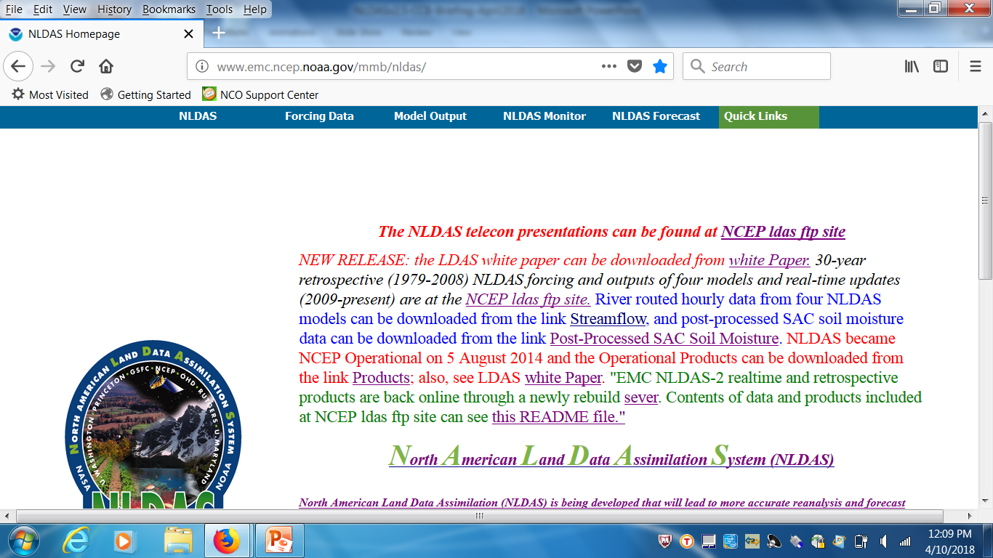
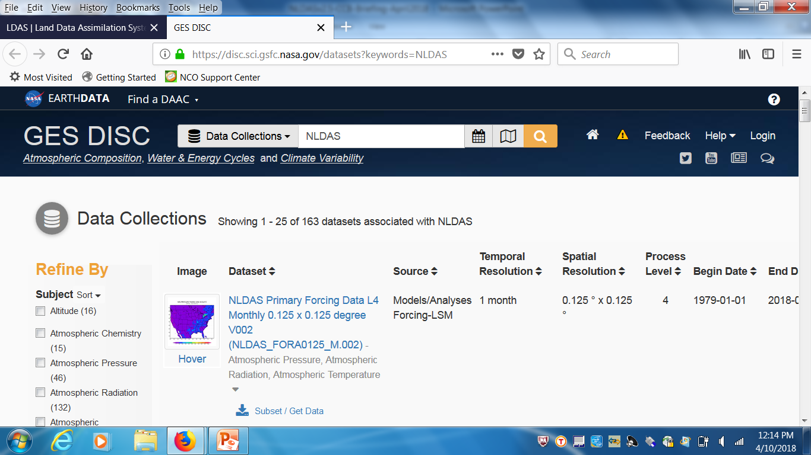
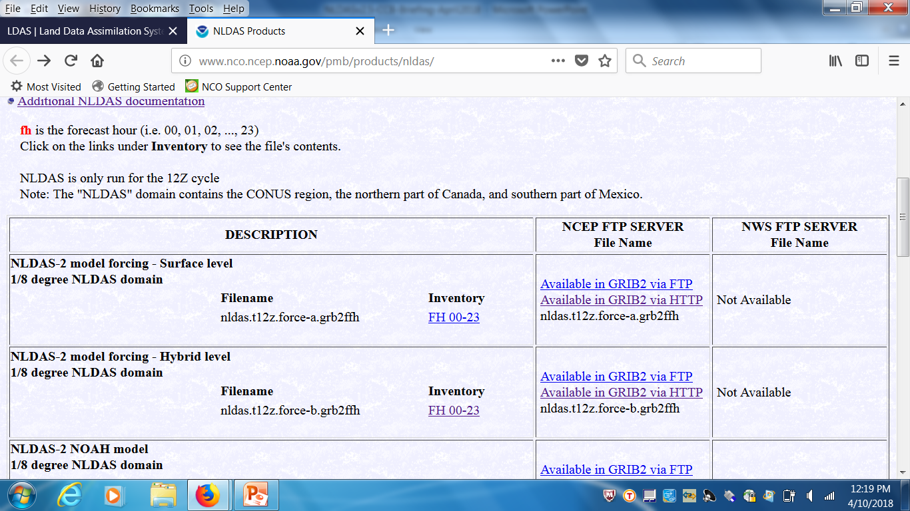
NLDAS v2.5: Data Distribution
We will provide thousands users real-time NLDAS products as soon as possible
http://www.emc.ncep.noaa.gov/mmb/nldas/
EMC LDAS ftp site -ftp://ldas.ncep.noaa.gov/
Other Distribution Sites: UCAR, USGS, CDC WONDER (Centers for Diseases Control and Prevention), etc.

Slide 22
Future Development of NCEP LDAS

Slide 23
NLDAS
Run NLDAS under NASA Land Information System (LIS) parallel environment, latest land model versions, land data assimilation and validation tools –LINK CTB.
Improve atmospheric and observational precipitation and air temperature forcing; data sets (e.g. land use, soils, greenness) – using latest reanalysis product (e.g., FV3) to reduce latency.
Improve land model physics (e.g., irrigation, ground water, vegetation dynamics, carbon and nitrogen cycle).
Land data assimilation: snow, soil moisture, GRACE TWS.
Test potential LSMs: CLM5, LM4, Noah-MP
Fit EMC strategic plan to simplify NCEP product suite purpose, unify NLDAS and GLDAS into NCEP unified LDAS (NULDAS), e.g., initial land cond. for FV3GFS.
23

Slide 24
R2O: Collaboration Research of NLDAS Development between EMC and NASA sponsored by CPO/MAPP
(NASA scientists, EMC scientists)
CPO/MAPP/NLDAS FY11-13:Assimilating Soil Moisture and Snow Products for Improved Drought Monitoring with the North American Land Data Assimilation System (NLDAS) DA (Peters-Lidard, Mocko, Kumar, Ek, Xia, Dong)
CPO/MAPP/NLDAS FY14-16: Advancing Probabilistic Drought Monitoring through Multisensor Ensemble DA (Peters-Lidard, Mocko, Kumar, Wamg, Ek, Xia, Dong)
CPO/CTB/NLDAS FY17-18:Operational Transition of Soil Moisture and Snow Data Assimilation in the North American Land Data Assimilation System (NLDAS) (Peters-Lidard, Mocko, Kumar, Ek, Xia, Dong)
CPO/MAPP/NLDAS FY18-20: Representing human-managed influences through thermal and vegetation product data assimilation in NLDAS: Impacts on the terrestrial water budget and drought estimation (Peters-Lidard, Mocko, Kumar, Hain, Xia)
These efforts are being integrated to use for NLDAS-3
Kumar et al., JHM, 2016; Kumar et al., WRR, 2017, Niu et al., JGR, 2011, Xia et al., JGR, 2016a &b; Xia et al., JHM, 2017

Slide 25
Interaction with other EMC projects and outside community
Speed up NULDAS development via unifying NLDAS and GLDAS (e.g., forcing generation, model choice, and system test)
Efficiently use radar, reanalysis and model product in NULDAS testbed via collaboration with EMC scientists
Enhance couple model system tests (e.g., FV3GFS) for land model (Noah, Noah-MP) to identify key parameters and processes to improve skills from sub-seasonal to seasonal forecast
Achieve standalone->SCM->fully coupled system test strategy
Enhance internal collaboration within EMC, in particular related to atmospheric and boundary layer physics processes – working two systems together
Speed up development and transition of land-related processes (lake, groundwater, irrigation, vegetation dynamics, wild fire, biochemistry, and ecosystem, global river router) to Noah or Noah-MP model to meet EMC coupled system requirements.
Use land model as a component to support for coupled system upgrade and development at EMC
Keep a close collaboration with OWP (e.g., forcing generation, NWM, verification data and tools, etc.)

Slide 26
References (EMC scientists are indicated in bold)
Kumar, S.V., S. Wang, D. M. Mocko, C.D. Peters-Lidard, and Y. Xia, 2017: Similarity Assessment of Land Surface Model Outputs in the North American Land Data Assimilation System (NLDAS). Water Resources Research, 53, 8941-8965.
Kumar, S.V., B. F. Zaitchik, C. D. Peters-Lidard, M. Rodell, R. Reichle, B. Li, M. Jasinski, D. Mocko, A. Getirana, G. De Lannoy, M. H. Cosh, C. R. Hain, M. Anderson, K. R. Arsenault, Y. Xia, and M. Ek, 2016: Assimilation of Gridded GRACE Terrestrial Water Storage Estimates in the North American Land Data Assimilation System, J. Hydrometeor., 17, 1951-1972.
Niu, G., Z.-L., Yang, K. E. Mitchell, F. Chen, M. B. Ek, M. Barlage, L. Longuevergne, M. Tewari, and Y. Xia, 2011: The community Noah land surface model with multiparameterization options (Noah-MP): 1. Model description and evaluation with local-scale measurements. J. Geophys. Res., 116, D12109, doi:10.1029/2010JD015139
Xia, Y., D.M. Mocko, M. Huang, B. Li, M. Rodell, K.E. Mitchell, X. Cai, and M.B. Ek, 2017: Comparison and Assessment of Three Advanced Land Surface Models in Simulating Terrestrial Water Storage Components over the United States. J. Hydrometeor., 18, 625-649.
Xia, Y., B. A. Cosgrove, K. E. Mitchell, C. D. Peters-Lidard, M. B. Ek, M. Brewer, D. Mocko, S. V. Kumar, H. Wei, J. Meng, and L. Luo, 2016a: Basin-scale Assessment of the Land Surface Water Budget in the NCEP Operational and Research NLDAS-2 Systems. J. Geophys. Res. - Atmos., 121 (6), 2750-2779.
Xia, Y., B. A. Cosgrove, K. E. Mitchell, C. D. Peters-Lidard, M. B. Ek, S.V. Kumar, D. Mocko, and H. Wei, 2016b: Basin-scale Assessment of the Land Surface Energy Budget in the NCEP Operational and Research NLDAS-2 Systems. J. Geophys. Res.- Atmos., 121 (1), 196-220.
Xia, Y., K. E. Mitchell, M. B. Ek, J. Sheffield, B. Cosgrove, E. Wood, L. Lou, C. Alonge, H. Wei, J. Meng, B. Livneh, D. Lettenmaier, V. Koren, Q. Duan, K. Mo, Y. Fan, and D. Mocko, 2012: Continental Water and Energy Flux Analysis and Validation for North-American Land Data Assimilation System Project Phase 2, Part 2: Comparison Analysis of Multi-model Results. J. Geophys. Res.- Atmos., 117, D03109, doi:10.1029/2011JD016048.
Preparation for NLDAS-3
NLDAS-2 ops and res

Slide 27
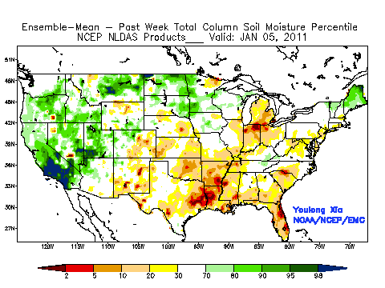
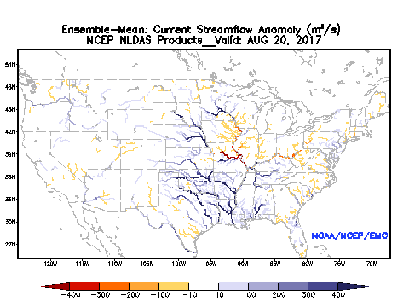
Thanks for your attention!
Comments and Suggestions:
Dr. Youlong Xia: Youlong.Xia@noaa.gov
Dr. Jack Kain: Jack.Kain@noaa.gov
Texas Drought (05Jan-14Sep 2011)
Weekly soil moisture percentile variation
Texas Flood (Harvey, 20Aug-20Sep, 2017)
Daily streamflow variation

